Slide 1
Sports Betting Arbitrage
Thomas Y. (Data Science), Josh L. (Data Science)
Deep dive into betting arbitrage how often opportunities occur

Slide 2
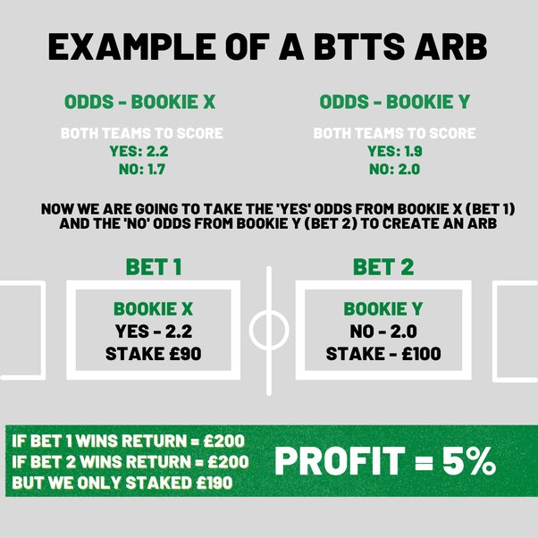
What is arbitrage betting?
“A way for gamblers to ensure a betting profit regardless of the outcome of a specific event”
This means if Team A wins or Team B wins a game the better will still make money. However, opportunities like this can be difficult to find.

Slide 3
Implied Odds
Implied probability refers to the overall likelihood of a betting outcome according to the listed odds.
Implied Probability
Fair odds = 1
Better for Book > 1
Better for Gambler < 1
50%
50%
100%
+100
+100
52.4%
52.4%
104.8%
-110
-110
47.6%
47.6%
95.2%
+110
+110

Slide 4
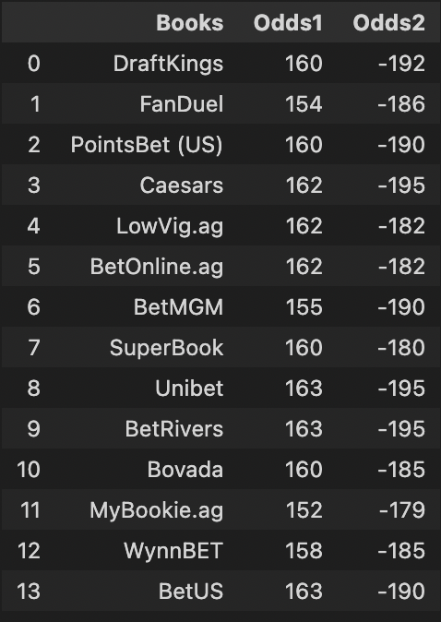
Finding Arbitrage Opportunities (before game)
Used Odds-API to get sports odds from sports books
New Orleans Pelicans vs Oklahoma City Thunder
Odds1
Odds2
Advantages
Disadvantages
+163
-179
38%
64.2%
Over 15 Sports Books
Only 500 free monthly requests
Implied Odds
70 different sports
1.02
Didn’t Include tie Odds
Since the Implied Odds are greater than 1, the odds are in favor of the book, and there is no arbitrage opportunity

Slide 5


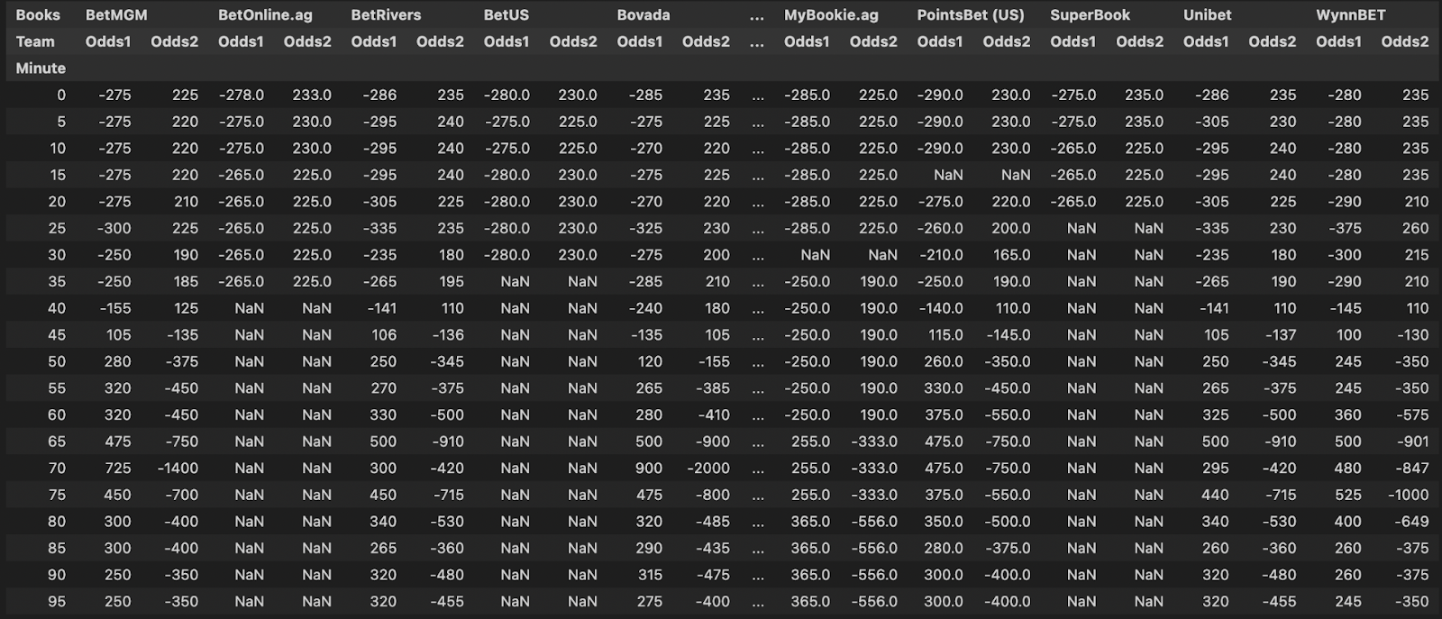
Finding Arbitrage Opportunities (during game) VS

Slide 6
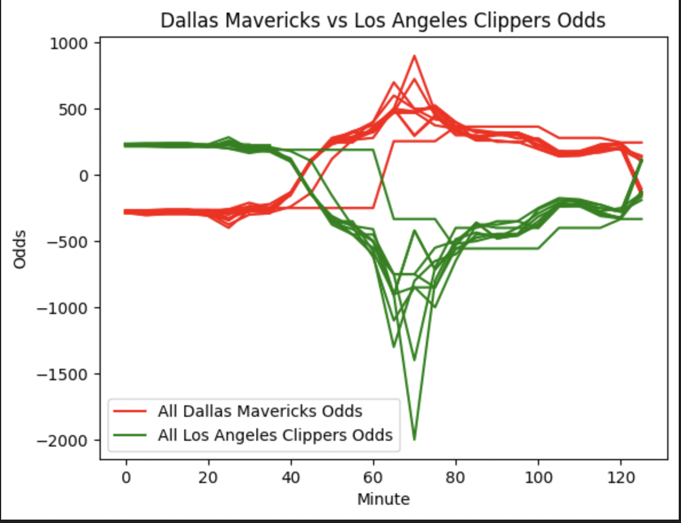
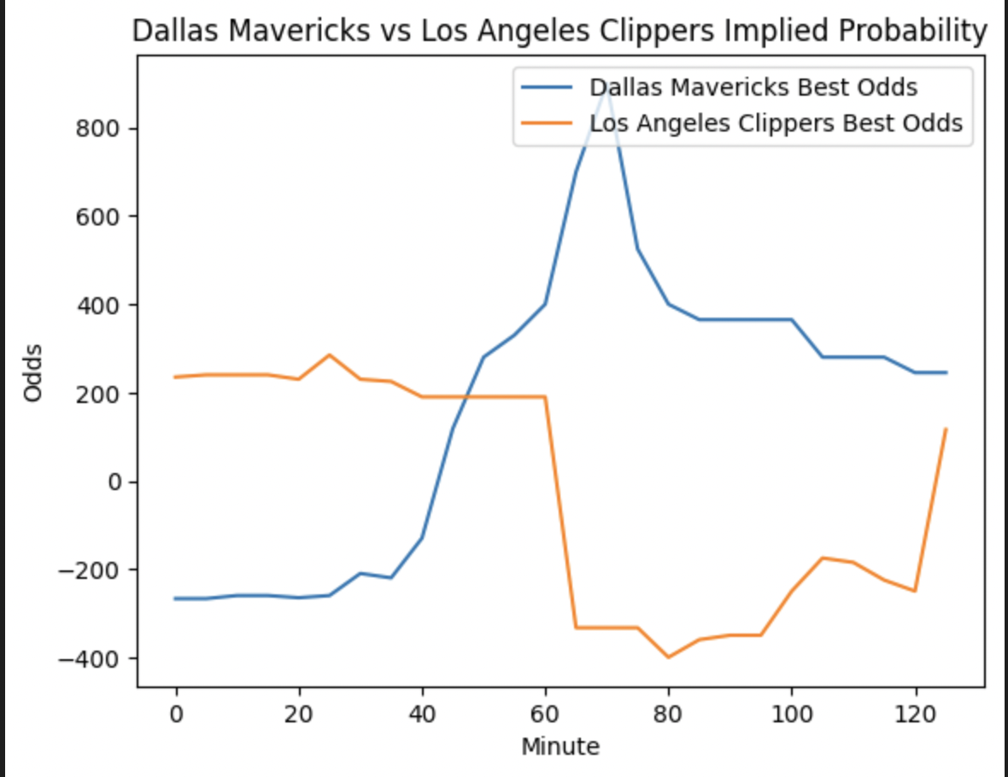
Finding Arbitrage Opportunities (during game) VS

Slide 7
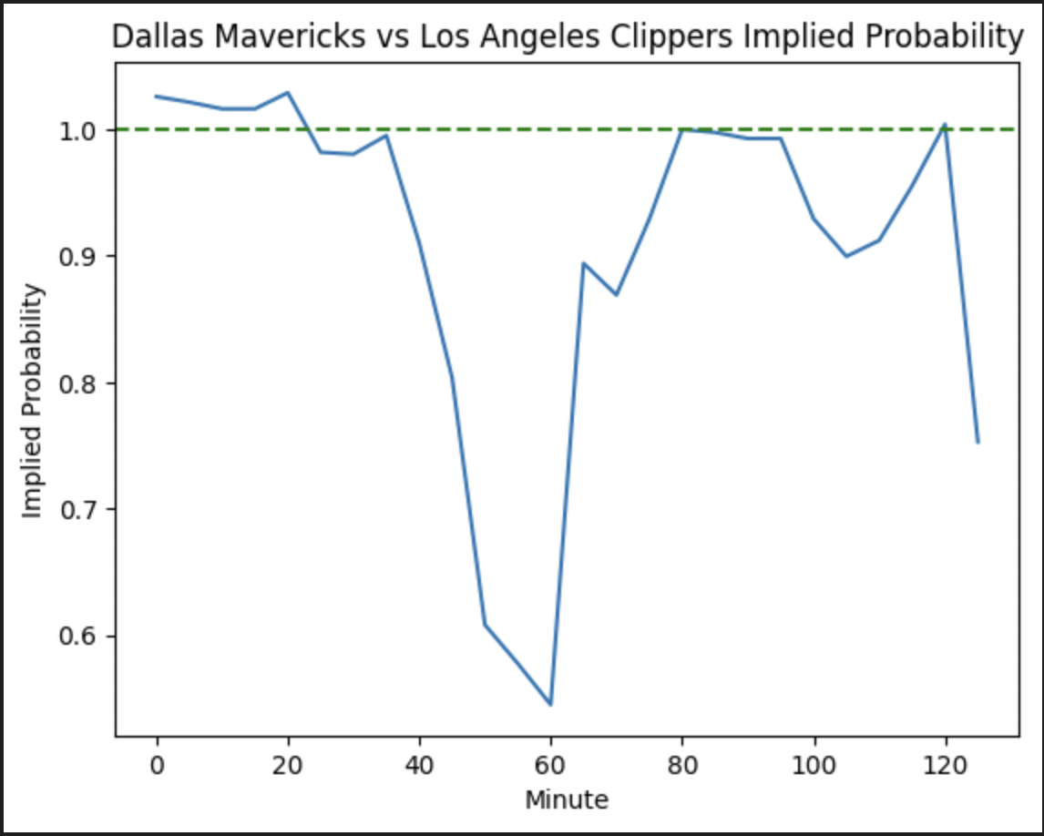
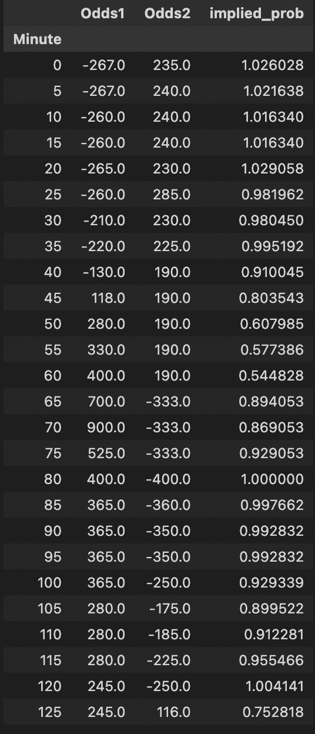
Implied odds for Mavericks vs Clippers
We looked at the implied odds throughout the Mavericks Clippers game last night
Since the Implied Odds are less than 1, the odds are in favor of the gambler, and there is an arbitrage opportunity
Future Considerations
Paid Odds-API Features
Web Scraping
Placing bets

